Slide 1
Review for Quiz 2

Slide 2

Practice for Quiz 1
Problem 1. Starting from the following system:
$2x−2y=−6$
$$x−y+z=1$$
$$3y−2z= −5$$
and using the Gauss-Jordan elimination, the following matrix has been obtained:
$$\left[\begin{aligned}1 0 \frac{1}{3} −\frac{2}{3} \\ 0 1 −\frac{2}{3} −\frac{5}{3} \\ 0 0 1 4\end{aligned}\right]$$
Continue the process (Jordan-Gauss) elimination to solve the system. State the values for x, y and z.

Slide 3







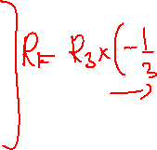
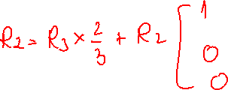
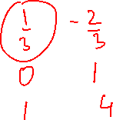
$\left[\begin{aligned}1 0 \frac{1}{3} −\frac{2}{3} \\ 0 1 −\frac{2}{3} −\frac{5}{3} \\ 0 0 1 4\end{aligned}\right]$

Slide 4



Problem 2
Establish if the following homogeneous system has a nontrivial solution. If a nontrivial solution exists, solve the system.
$3x−y+z=0$
$x+2y−x=0$

Slide 5







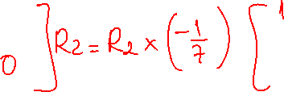
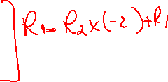




















Slide 6













Problem 3
Solve the system associated with the following matrix:
A) $\left[\begin{aligned}1 0 3 4 \\ 0 1 −2 3 \\ 0 0 0 0\end{aligned}\right]$
B) $\left[\begin{aligned}1 0 0 4 \\ 0 1 0 3 \\ 0 0 1 −1\end{aligned}\right]$

Slide 8









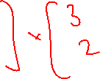







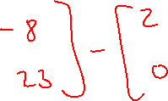


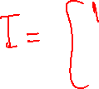




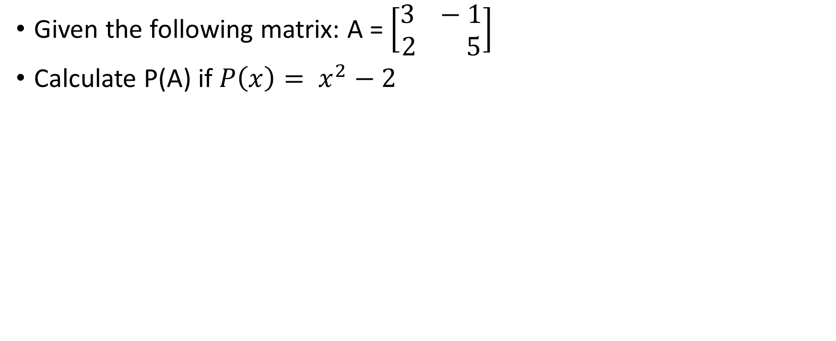
Problem 4
Given the following matrix: A = $\left[\begin{aligned}3 −1 \\ 2 5\end{aligned}\right]$
Calculate P(A) if $P\left(x\right)= x^{2}−2$

Slide 10
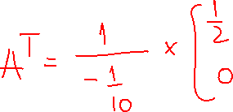



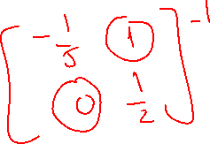
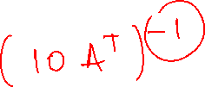





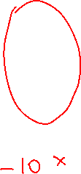



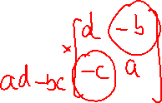
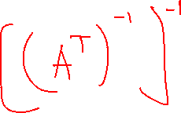




Problem 5 Solve for A:
${{10(A}^{T})}^{−1}=\left[\begin{aligned}−2 10 \\ 0 5\end{aligned}\right]$

Slide 11




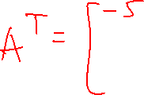
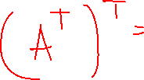


Slide 12





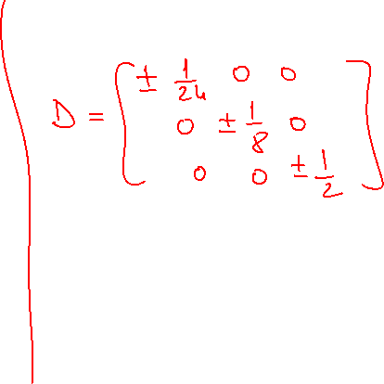






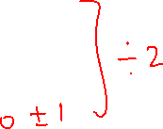
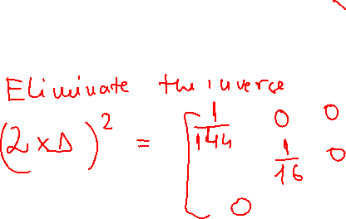


Problem 6 Find a diagonal matrix D, using the information below:
${(2×D)}^{−2}= \left[\begin{aligned}144 0 0 \\ 0 16 0 \\ 0 0 1\end{aligned}\right]$

Slide 14








Problem 7 Find the values of x and y for which the following matrix is symmetrical:
$$B= \left[\begin{aligned}2 x−3 0 \\ 7 5 2 \\ 2y+1 2 5\end{aligned}\right]$$

Slide 16
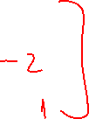

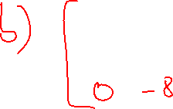



Problem 8
Given the matrix below, perform the following row operation:
R2 being replaced by R2 – 4R1?
R3 being replaced by R3 - 3R1?
$\left[\begin{aligned}1 3 5 1 \\ 4 −1 2 2 \\ 3 1 0 1\end{aligned}\right]$

Slide 18




















Problem 9
For the following matrix, find:
A = $\left[\begin{aligned}1 −4 2 \\ 3 0 1 \\ 2 1 1\end{aligned}\right]$
a) The matrix of cofactors
b) The adjoint of the matrix
c) The determinant of the matrix
d) The inverse of the matrix

Slide 19


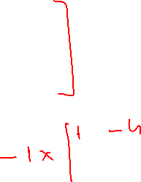


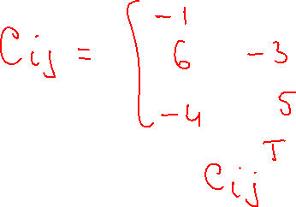








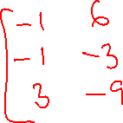


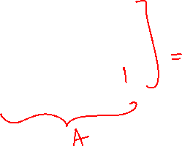

Slide 20


















Slide 21

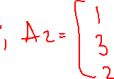












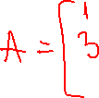



Problem 10
Solve the following system for y.
$x – 4y +2z=5$
$3x+z=5$
$2x+y+z=4$

Slide 22






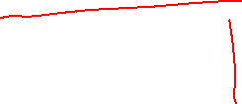









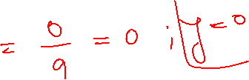









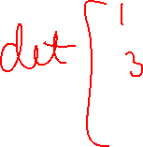

Slide 23






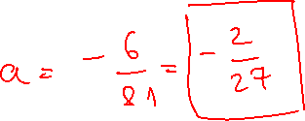
















Problem 11
Find a so that the following matrix is not invertible.
$C=\left[\begin{aligned}3 2a 0 \\ 0 5a 1 \\ 3 −2 5\end{aligned}\right]$

Slide 24









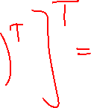
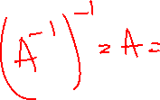





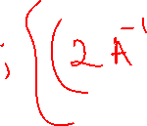



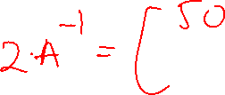






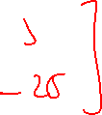
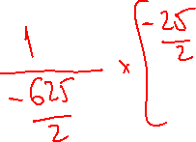

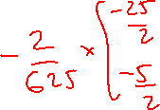




Slide 25


































Slide 26











